Slide 1

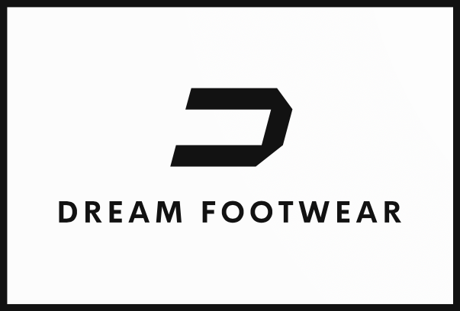

Slide 2
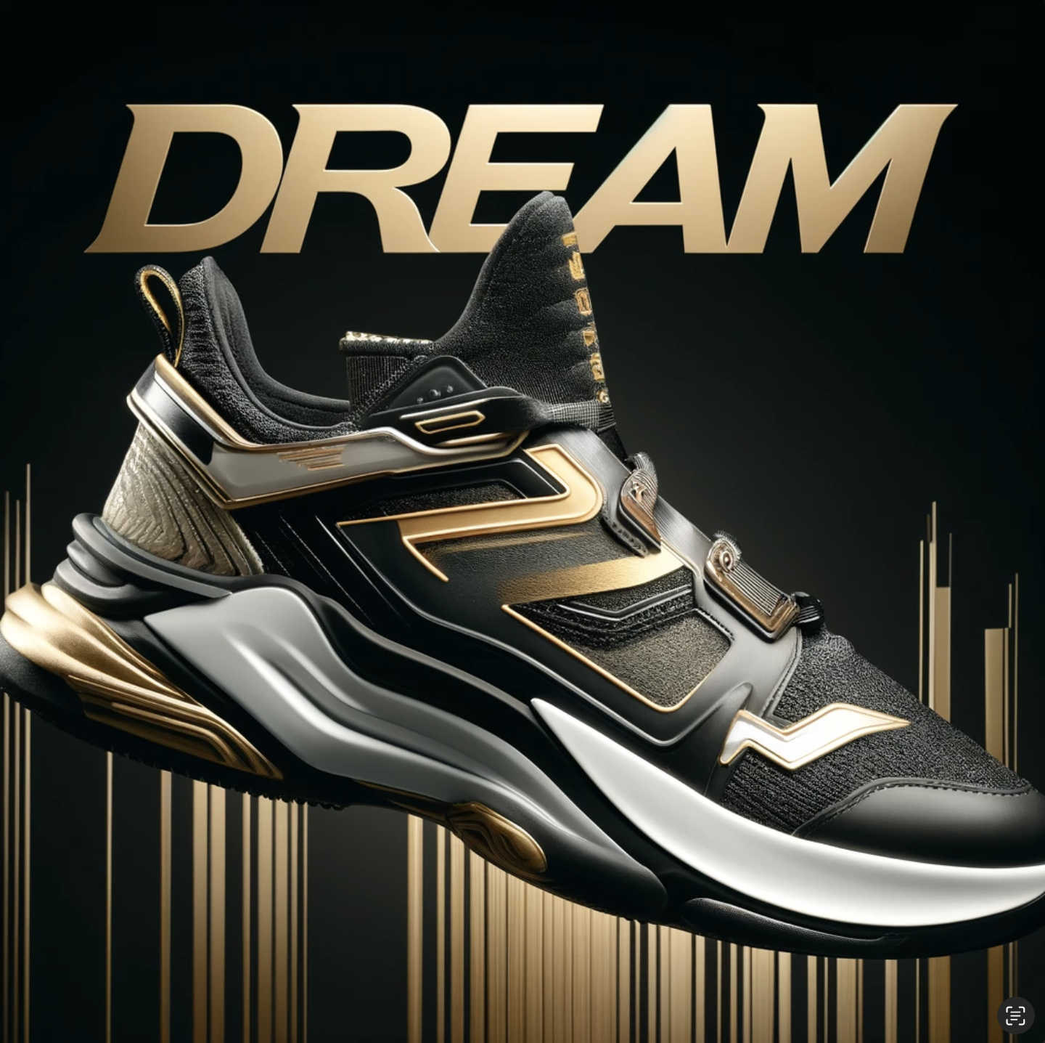

Dream Big, Dream Comfort, Dream Footwear!
Dreaming Is Free!
Antoni Diaz
Dani Guandique
Kyle Porter

Slide 3
The Rundown
Our Vision
Mission Statement & Core Values
Footwear Industry Overview
Years 11-13 | Years 14-16 | Years 17-20
Current Company Overview
The Marathon Ahead…

Slide 4
Vision
Be the go-to brand for affordable, quality athletic footwear making active lifestyles achievable to everyone around the globe.
Affordable
Quality
Comfort

Slide 5
Mission Statement & Core Values
We are innovators, designers, and advocates of active living, dedicated to providing athletes and fitness enthusiasts of all levels with high-quality, sustainable athletic footwear. Our mission is to empower every individual to reach their peak performance and support their journey towards a healthier, more active lifestyle. We do this by leveraging never before seen technology, sustainable materials, and inclusive design to create footwear that not only boosts performance but also champion the health of our planet and the diverse needs of our global community.
Why are we here? To inspire movement, foster environmental stewardship, and celebrate the spirit of athleticism in everyone, everywhere.
Innovation & Excellence
Inclusivity & Diversity
Customer-Centricity
Integrity & Transparency
*FYI: Dani has mild dyslexia.*
Notes:
I don’t like reading off slides tbh but since I have mild visual dyslexia you’ll be able to bear with me on these ones.

Slide 6
Footwear Industry Overview
01
02
03
Companies
Market Segments
Regions
Alpha Shoe Company
Bounce N’ Bolt
Craft Footwear
Dream Footwear
Essential Shoe Company
Frontrunner
Wholesale
Internet
Private Label
North America
Latin America
Asia-Pacific
Europe-Africa

Slide 7
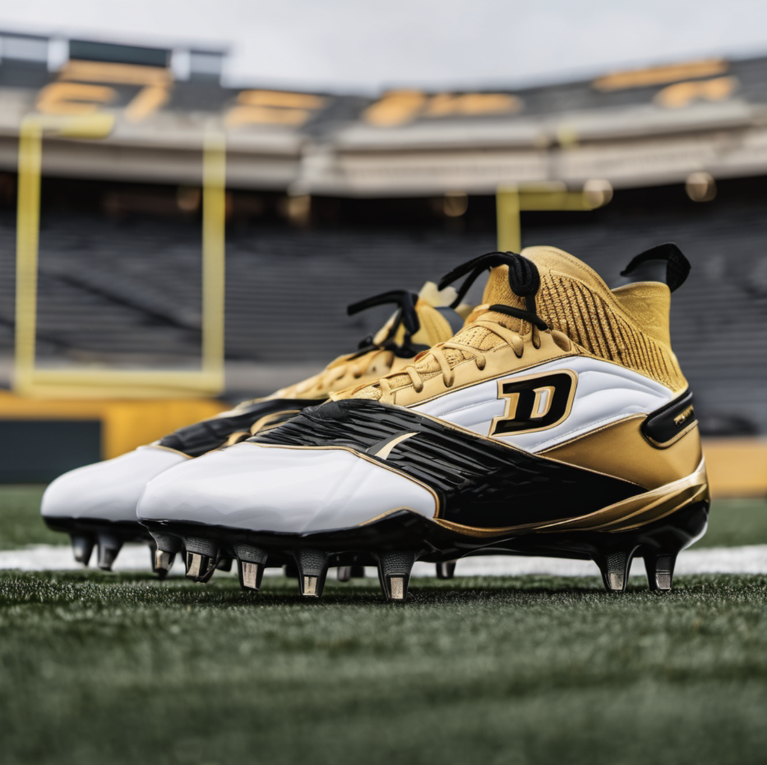
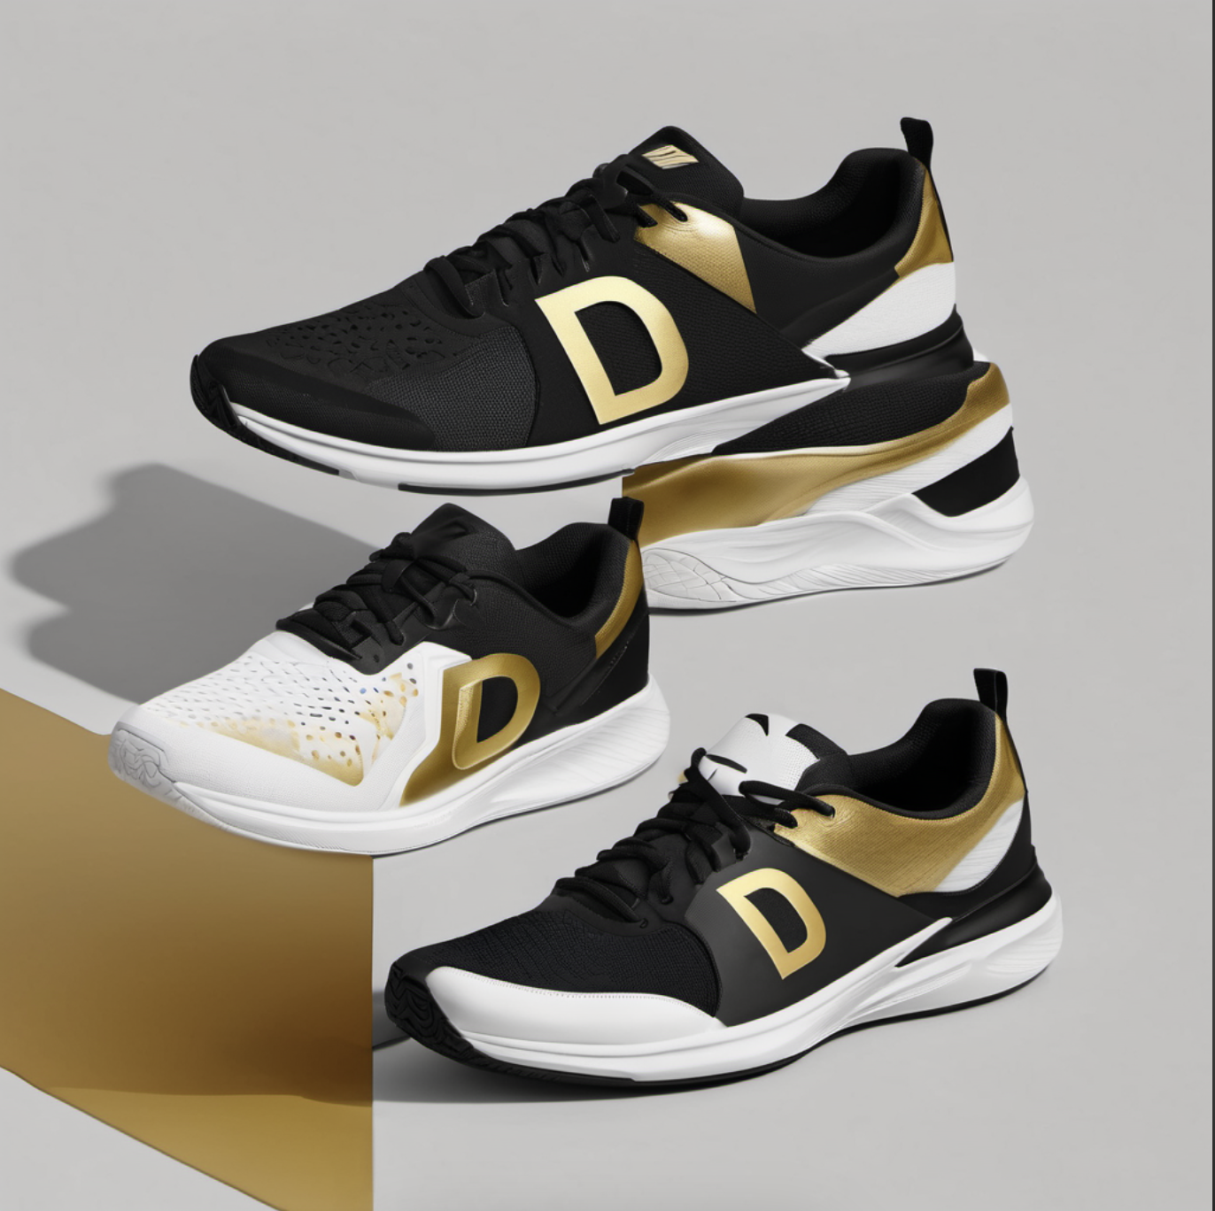
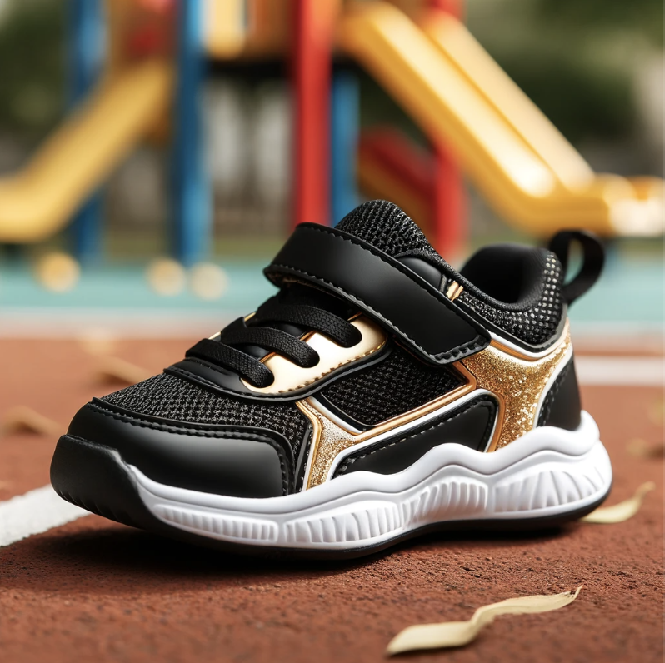
Years 11-13
Low Cost Provider
Trying To Find Our Place In The Market
Fine Tuning Production
Conservative Decision Making

Slide 8
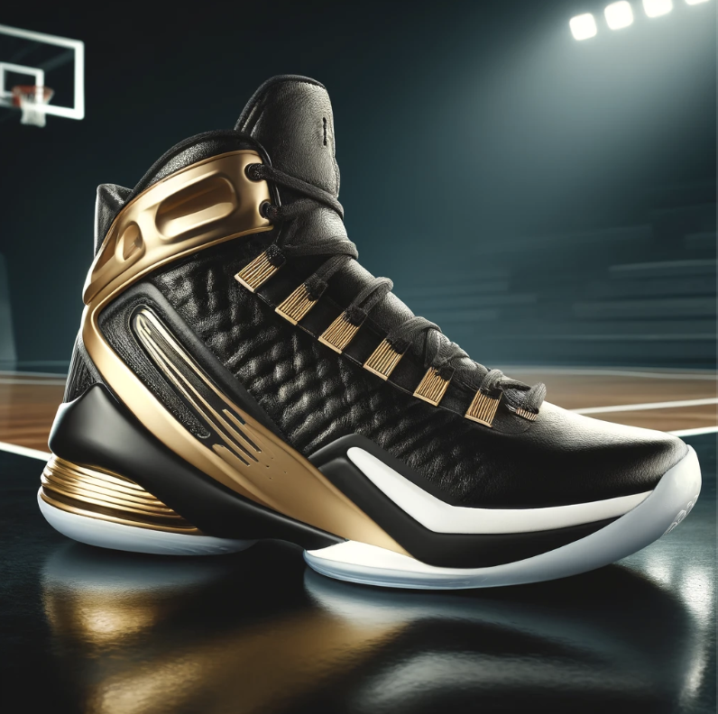
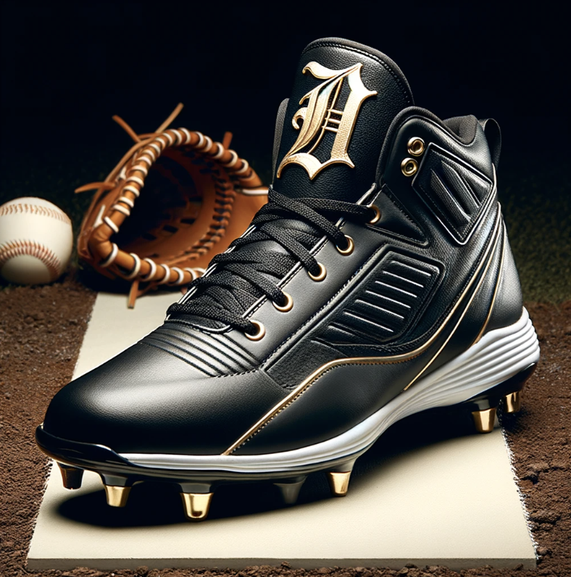
Strengths & Weaknesses
Strengths
Weaknesses
Little To No Spending On Marketing
No Celebrities
Low S/Q rating
Low Brand reputation
Production Margins
Factory Layout upgrade
Private-Label
Credit Rating & Financials

Slide 9
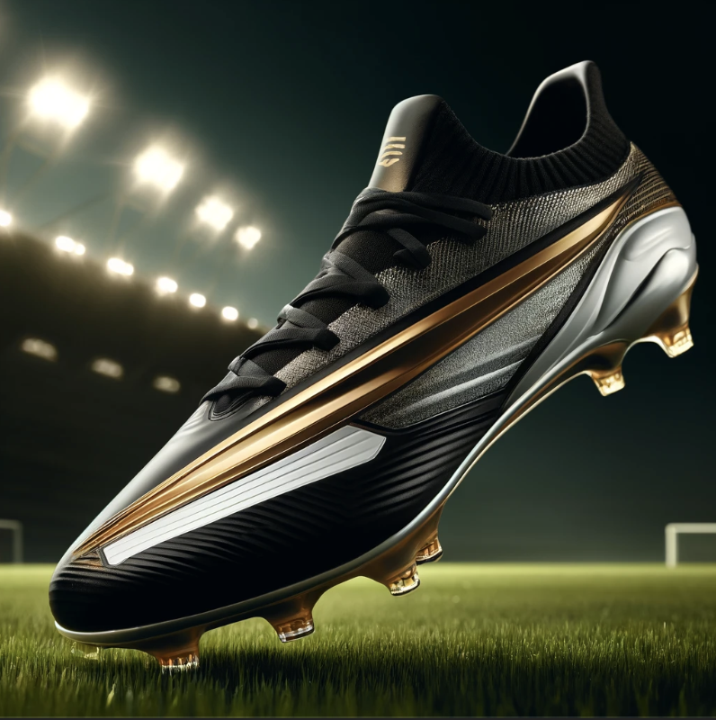
Years 14-16
Things To Know
Opened Facility In Latin America and Europe-Africa
Shifting Labor & Production to Latin America and away from North America

Slide 10
Strengths & Weaknesses
Strengths
Weaknesses
Early Shift Into Latin America & Europe-Africa
Start Of Best Practices Training Initiative
Purchased Special Equipment For S/Q
Over Reliance On Private-Label
Still Limited Marketing Expenditure Compared To Market
Producing too many shoes

Slide 11
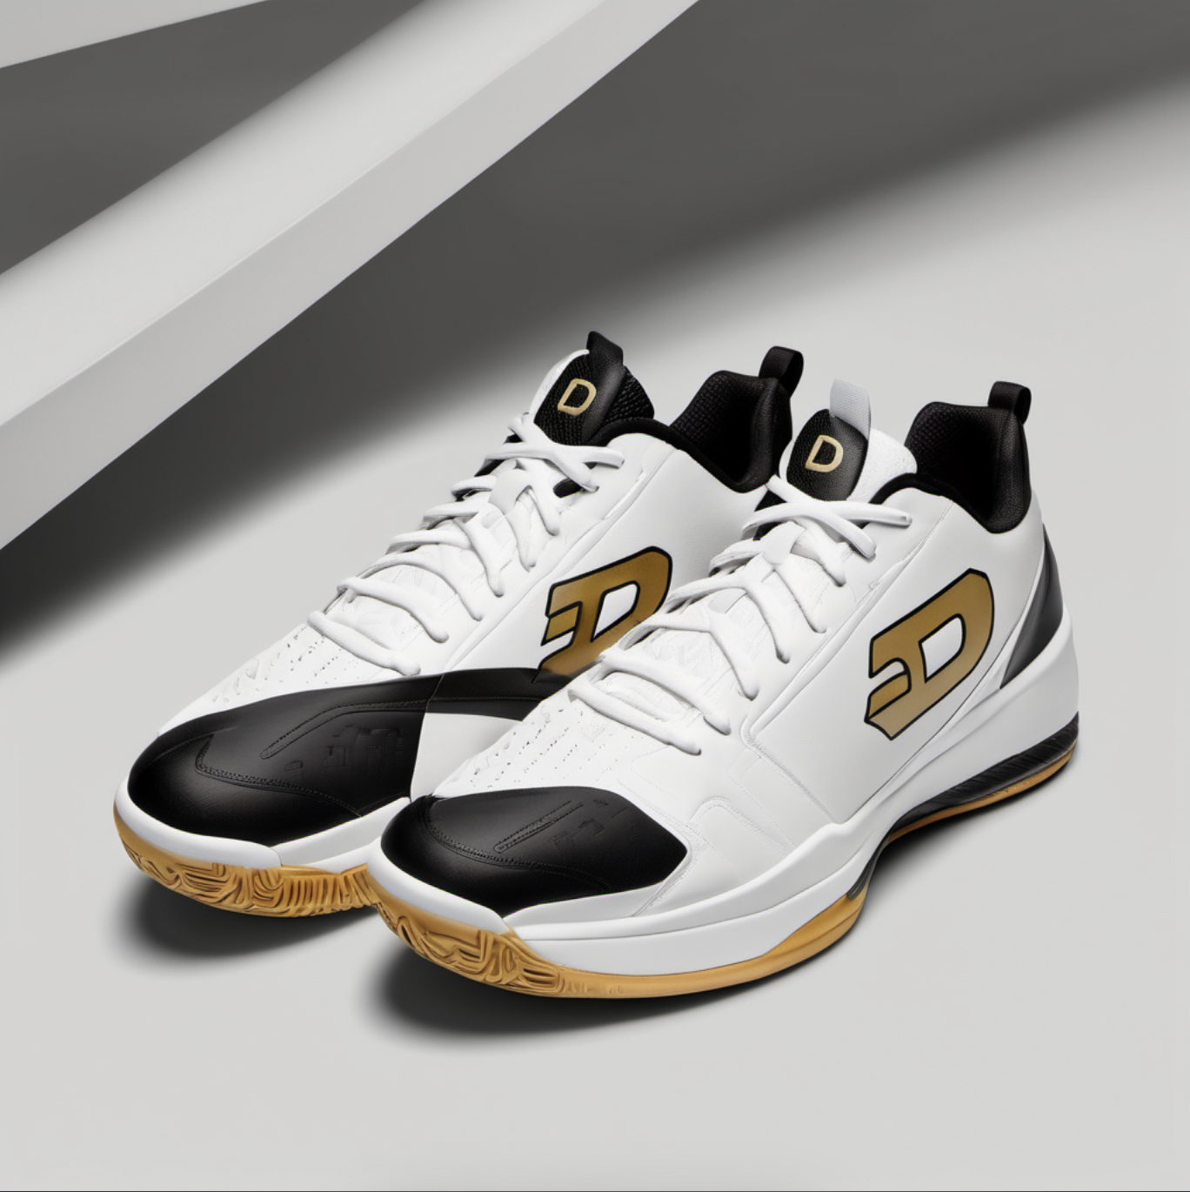
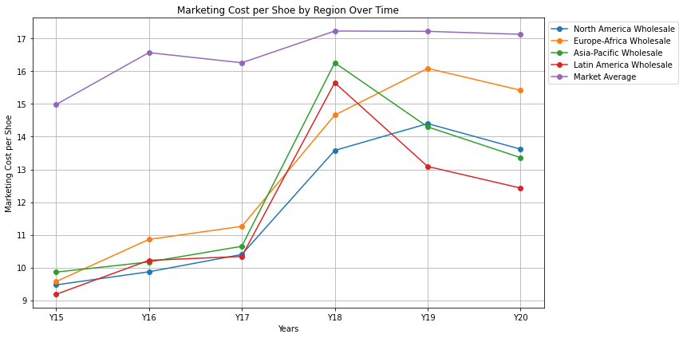
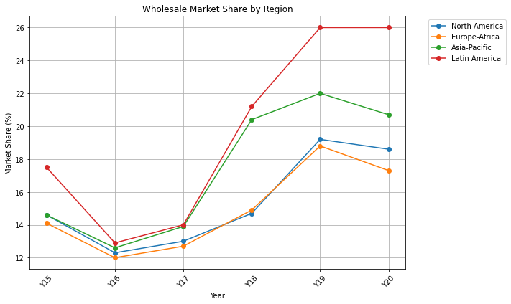
Years 17-20
Shift From Low Cost Provider To Best Cost
Increased Our Marketing Efforts In A Two Staged Approach
Started Stock Buyback Initiative
Pivot Away From Private Label To Full Branded Production
Notes:
Transparency is on the next slide.

Slide 12
Strengths & Weaknesses
Strengths
Weaknesses
Increased Celebrity Presence
Use Of Surplus Shoes To Manage Shift To High Demand Production
Purchased Special Equipment For S/Q
Lack Of Production Mass Production Capabilities Early
Over Reliance On Celebrities
Increase In Global Tariffs

Slide 13
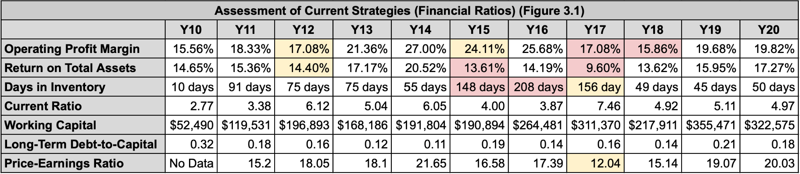
Current Company Overview
Industry-Leader In Production Capacity
Sold 18,895,000 Branded Shoes Double What We Sold In Year 17
Reimplantation Of Private Label
Higher Quality For A Lower Cost

Slide 14
The Marathon Ahead…
Strategic Partnerships & Acquisitions
Strengthen Private-Label
Search For New Celebrities & Enter Influencer Market
Increase Corporate Responsibility

Slide 15
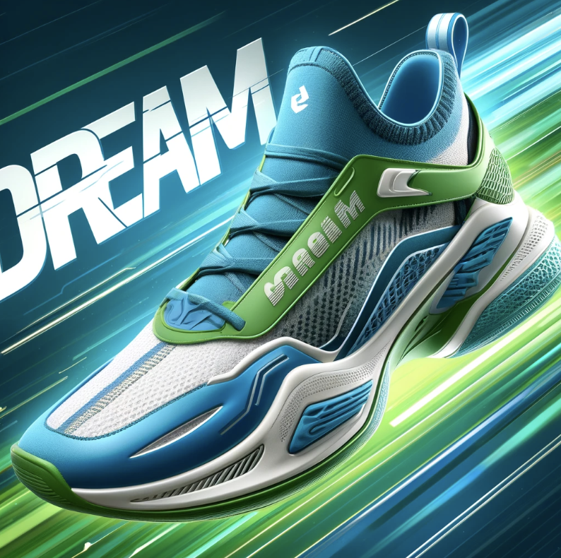
Dream Big, Dream Comfort, Dream Footwear!
Remember, Dreaming Is Free!
dream@gmail.com
1-800-DRM-SHOE
dreamfootwear.com
Notes:
Group F, we’re not here to take part, we’re here to takeover
Alpha don’t forgot about Y17, when at our lowest I asked for a merger and y’all said no…beta shoe company has a better ring to it, don’t ya think?
Rated E (and I don’t mean Essential) I mean for everyone!
Group B, you're like a mystery novel with no climax, all build-up with no facts.
And Group C, you're the sequel no one asked for, just a rerun of mistakes galore.

